Slide 1
Lecture 6

Slide 2
Relevance of Exchange Rate Risk
Exchange rates are extremely volatile.
The Australian dollar value of an MNC’s future payables or receivables in a foreign currency can change substantially in response to exchange rate movements.

Slide 3
Relevance of Exchange Rate Risk
The Investor Hedge Argument: exchange rate risk is irrelevant because investors can hedge exchange rate risk on their own
Currency Diversification Argument: if Australia-based MNC is well diversified across numerous currencies, its value will not be affected by exchange rate risk
Stakeholder Diversification Argument: if stakeholders are well diversified, they will be somewhat insulated against losses due to MNC exchange rate risk

Slide 4
Relevance of Exchange Rate Risk
Response from MNCs
Many MNCs attempt to stabilise their earnings with hedging strategies because they believe exchange rate risk is relevant.
Since BP has global operations, fluctuations in foreign currency exchange rates can have a significant effect on the group’s reported results.
— BP
Increased volatility in foreign exchange rates … may have an adverse impact on our business results and financial condition.
—PepsiCo

Slide 5
Relevance of Exchange Rate Risk
Forms of Exchange Rate Exposure
  Transaction exposure
  Economic exposure
  Translation exposure

Slide 6
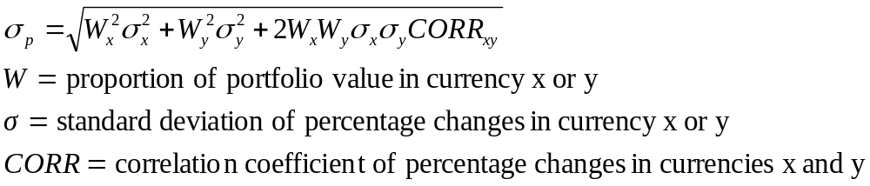
Transaction Exposure
Definition: sensitivity of the firm’s contractual transactions in foreign currencies to exchange rate movements.
Assessing transaction exposure:
Estimating net cash flows in each currency
Exposure of an MNC’s portfolio
  Measure potential impact of the currency exposure

Slide 7
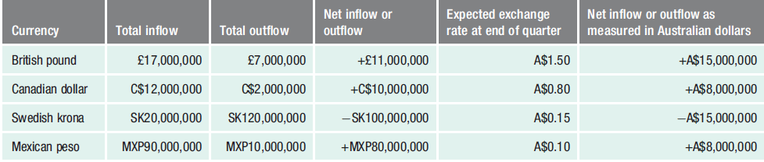
Consolidated Net Cash Flow Assessment of Lorna Jane Co.

Slide 8
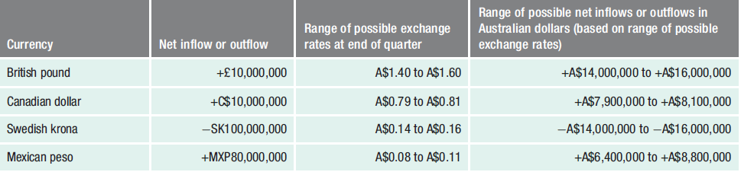
Estimating the Range of Net Inflows or Outflows for LORNA Jane Co.

Slide 9
TRANSACTION Exposure
Exposure of an MNC’s Portfolio
Measurement of currency volatility
  The standard deviation statistic measures the degree of movement for each currency. In any given period, some currencies clearly fluctuate much more than others
Currency volatility over time
  The volatility of a currency may not remain consistent from one time period to another. An MNC can identify currencies whose values are most likely to be stable or highly volatile in the future
Measurement of currency correlations
  The correlations coefficients indicate the degree to which two currencies move in relation to each other

Slide 10
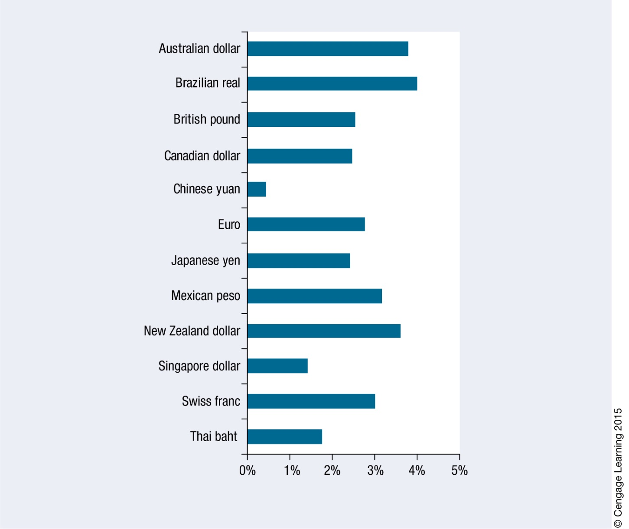
Standard Deviation of Exchange Rate Movements Based on Quarterly Exchange Rates, 2007–2012

Slide 11
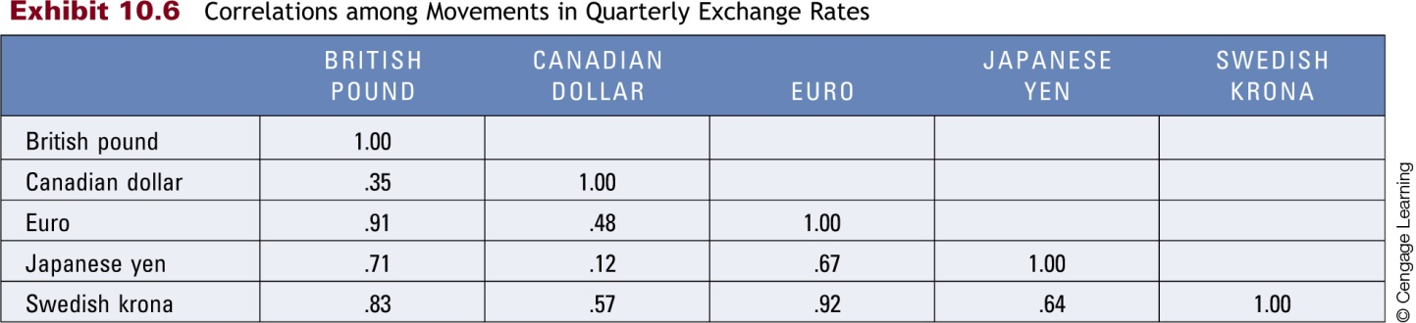
Correlations among Movements in Quarterly Exchange Rates

Slide 12
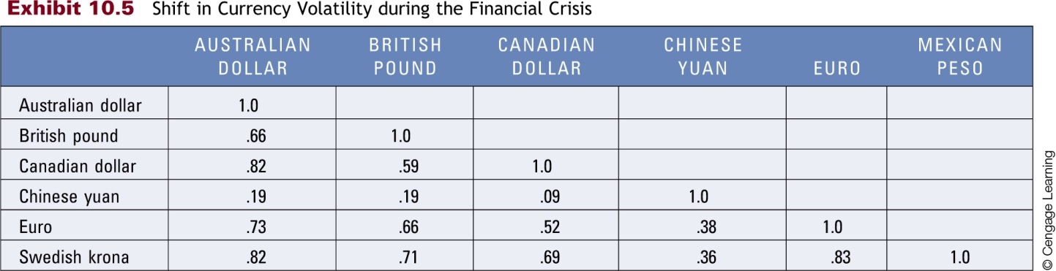
Shift In Currency Volatility During The Financial Crisis

Slide 13
TRANSACTION Exposure
Exposure of an MNC’s Portfolio
Applying currency correlations to net cash flows
  If a MNC has positive net cash flows in various currencies that are highly correlated, it may be exposed to exchange rate risk.
  However, many MNCs have some negative net cash flow positions in some currencies to complement their positive net cash flows in other currencies.
Currency correlations over time
  Because currency correlations change over time, an MNC cannot use previous correlations to predict future correlations with perfect accuracy.

Slide 14
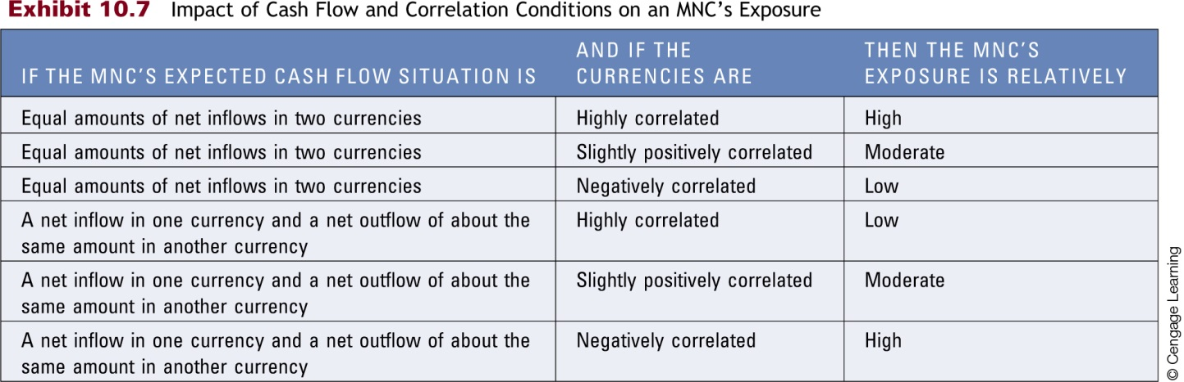
Impact of Cash Flow and Correlation Conditions on an MNC’s Exposure

Slide 15
Transaction Exposure
Transaction Exposure Based on Value at Risk (VaR)
Measures the potential maximum 1-day loss on the value of positions of an MNC that is exposed to exchange rate movements.
Factors that affect the maximum 1-day loss:
  Expected percentage change in the currency rate for the next day.
  Confidence level used.
  Standard deviation of the daily percentage changes in the currency.

Slide 16
Transaction Exposure
Transaction Exposure Based on Value at Risk (VaR)
Applying VaR to Longer Time Horizons
  The standard deviation should be estimated over the time horizon in which the maximum loss is to be measured
Applying VaR to Transaction Exposure of a Portfolio
  Since MNCs are commonly exposed to more than one currency, they may apply the VaR method to a currency portfolio. When considering multiple currencies, software packages can be used to perform the computations

Slide 17
Transaction Exposure
Transaction Exposure Based on Value at Risk (VaR)
Estimating VaR with an Electronic Spreadsheet
  Obtain the series of exchange rates for all relevant dates for each currency of concern and list each currency in its own column
  Compute the percentage changes per period (from one date to the next) for each exchange rate in a column
  Estimate the standard deviation of the column of percentage changes for each exchange rate
  In a separate column, compute the periodic percentage change in the portfolio value by applying weights to the individual currency returns.
  Use a compute statement to determine the standard deviation of the column of percentage changes in the portfolio value

Slide 18
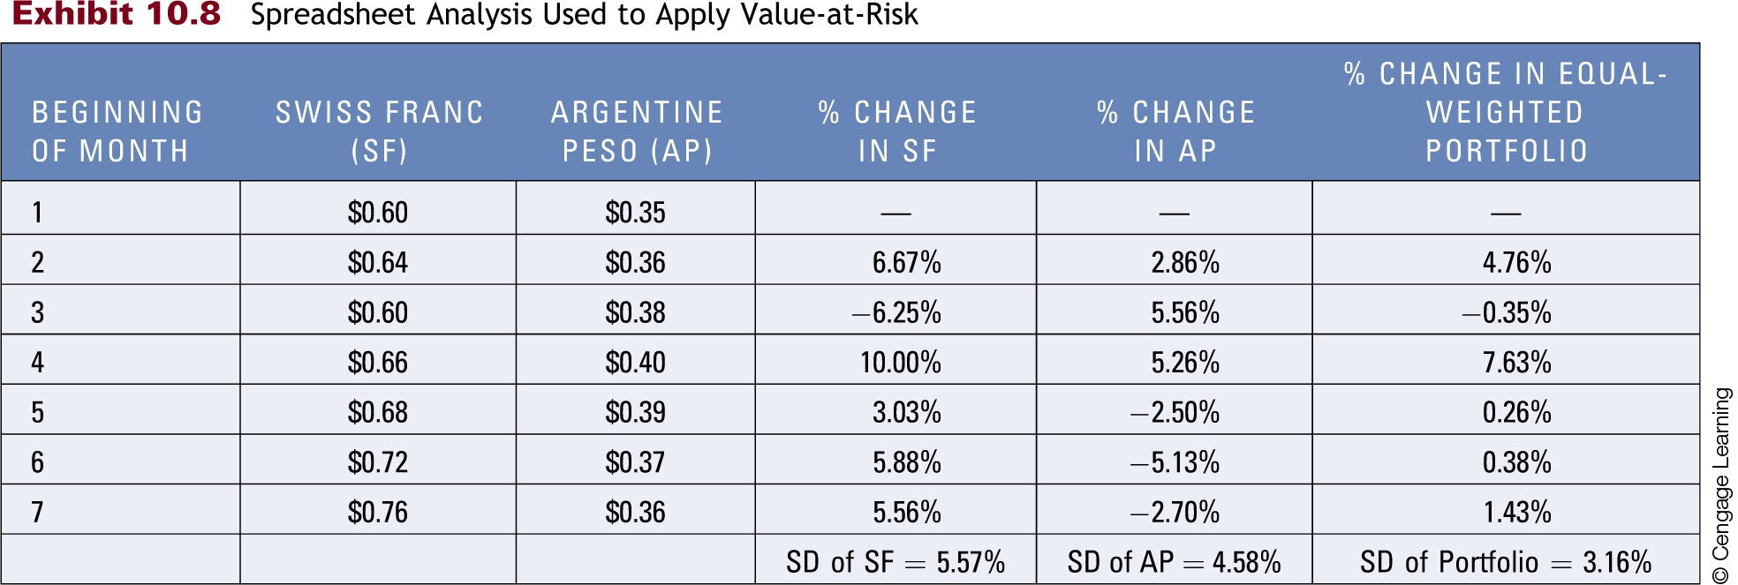
Spreadsheet Analysis Used to Apply Value-at-Risk

Slide 19
Transaction Exposure
Transaction Exposure Based on Value at Risk (VaR)
Limitations of VaR
  If the distribution of exchange rate movements is not normal, the estimate of the maximum expected loss is subject to error.
  The VaR method assumes that the volatility (standard deviation) of exchange rate movements is stable over time.
  If exchange rate movements are less volatile in the past than in the future, the estimated maximum expected loss derived from the VaR method will be underestimated.

Slide 20
Economic Exposure
Definition: The sensitivity of the company’s cash flows to exchange rate movements, sometimes referred to as operating exposure.
  Exposure to local currency appreciation
    Appreciation in the company’s local currency causes a reduction in both cash inflows and outflows.
    The impact on a company’s net cash flows will depend on whether the inflow transactions are affected more or less than the outflow transactions
  Exposure to local currency depreciation
    Depreciation of the company’s local currency causes an increase in both cash inflows and outflows
  Economic Exposure of Domestic companies
    Even purely domestic companies are affected by economic exposure

Slide 21
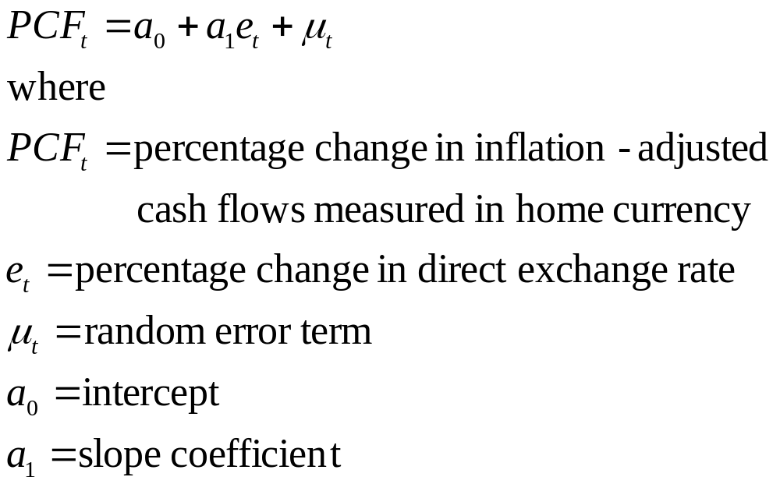
Economic Exposure
Measuring Economic Exposure
Using sensitivity analysis
Consider how sales and expense categories are affected by various exchange rate scenarios
Use of regression analysis

Slide 22
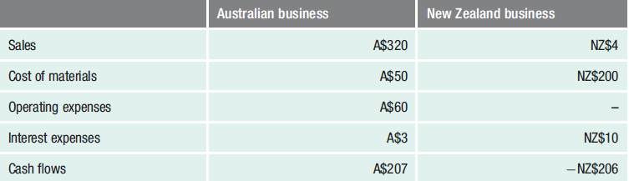
Estimated Sales and Expenses for Murray goulburn’s Australian and NZ Business Segments (millions of currency units)

Slide 23
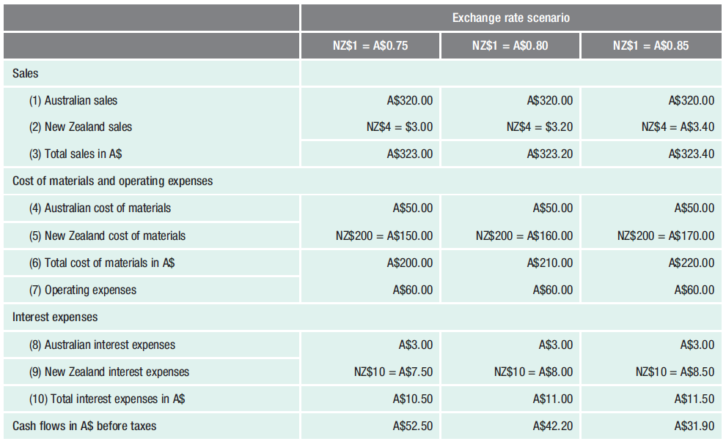
Impact of Possible Exchange Rates on Cash Flows of Murray goulburn Coop.
(millions of currency units)

Slide 24
Translation Exposure
Definition: The exposure of the MNC’s consolidated financial statements to exchange rate fluctuations.
Determinants of translation exposure:
  Proportion of business by foreign subsidiaries: The greater the percentage of an MNC’s business conducted by its foreign subsidiaries, the larger the percentage of a given financial statement item that is susceptible to translation exposure
  Locations of foreign subsidiaries: Location can also influence the degree of translation exposure because the financial statement items of each subsidiary are typically measured by the respective subsidiary’s home currency

Slide 25
Translation Exposure
Determinants of translation exposure
Accounting Methods: MNC translation exposure is affected by accounting procedures, many of which are based on AASB 121
The functional currency of an entity is the currency of the economic environment in which the entity operates
The current exchange rate as of the reporting date is used to translate the assets and liabilities of a foreign entity from its functional currency into the reporting currency

Slide 26
Translation Exposure
Determinants of translation exposure
Accounting Methods
The weighted average exchange rate over the relevant period is used to translate revenue, expenses, and gains and losses of a foreign entity from its functional currency into the reporting currency
Translated income gains or losses due to changes in foreign currency values are not recognised in current net income but are reported as a second component of stockholder’s equity; an exception to this rule is a foreign entity located in a country with high inflation
Realised income gains or losses due to foreign currency transactions are recorded in current net income, although there are some exceptions

Slide 27
Translation Exposure
Exposure of an MNC’s Stock Price to Translation Effects
Because an MNC’s translation exposure affects its consolidated earnings, it can affect the MNC’s valuation.
Signals that complement translation effects:
exchange rate conditions that cause a translation effect can also signal changes in expected cash flows in future years.
Such changes could also influence the stock price.
Exposure of managerial compensation to translation effects:
Since an MNC’s stock may be subject to translation effects and since managerial compensation is often tied to the MNC’s stock price, it follows that managerial compensation is affected by translation effects.

